Slide 1


Notes:
Easter egg.

Slide 2
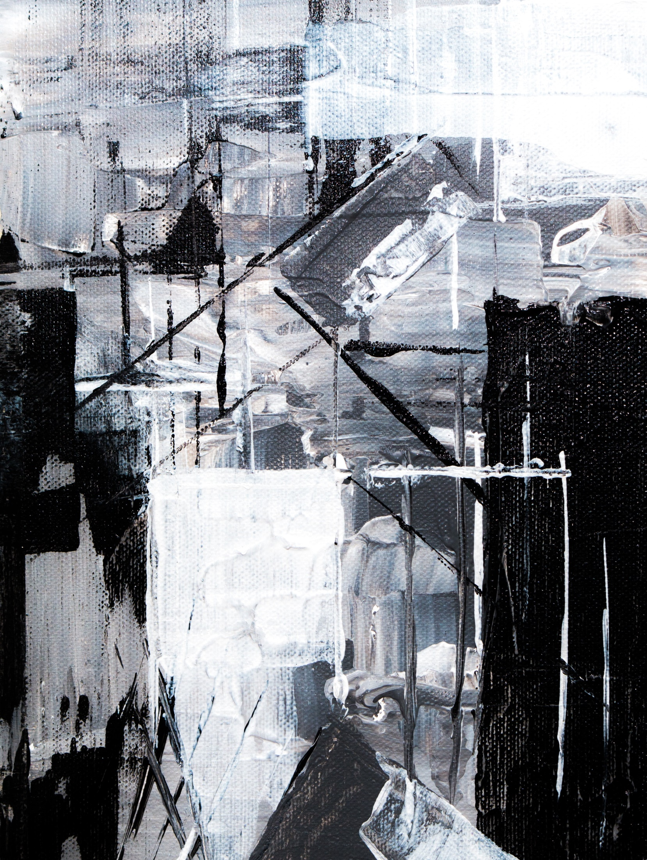

Notes:
Introduce the team.

Slide 3

Team Members
Eknoor Singh – 18BCS3620
Nishtha Mittal – 18BCS4263
Saksham Sharma – 18BCS4265
Binni Goel – 18BCS4339
Ishita Garg – 18BCS4303

Slide 4



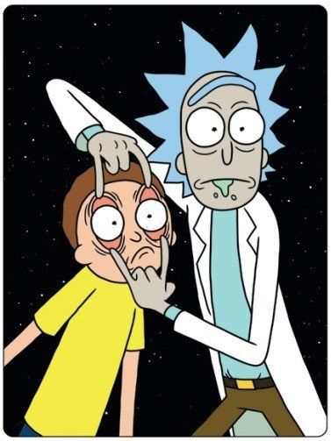
Warming Planet, Cool Ideas
Notes:
Just breeze through the title.

Slide 5

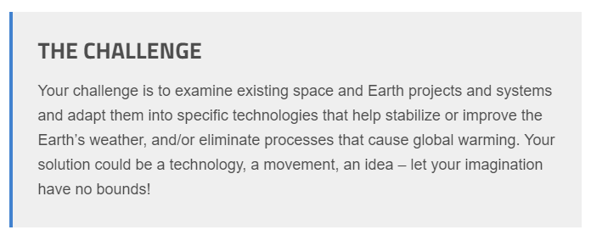
Notes:
Don’t dictate it as everyone has read it.

Slide 6





Notes:
Why did we choose this particular challenge.

Slide 7


Notes:
Just for fun.

Slide 8





Notes:
Talk about the Montreal protocol and Paris climate agreement and how they are the different aspects of the same coin.

Slide 9
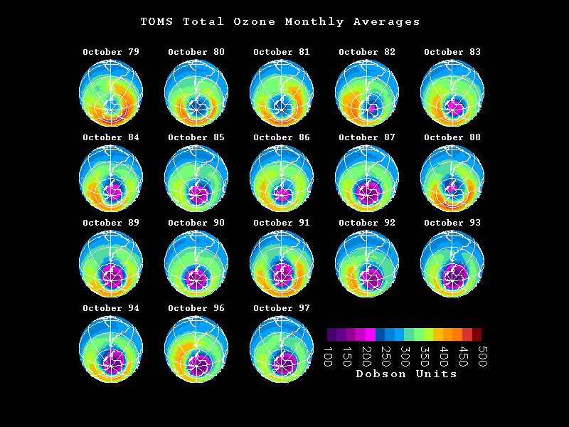
Notes:
Ozone layer depletion.

Slide 10


Notes:
Just for humor.

Slide 11

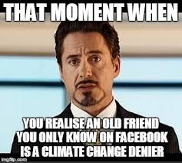
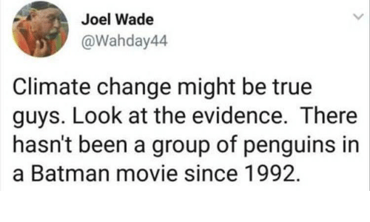
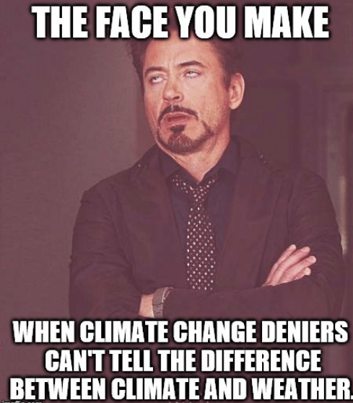
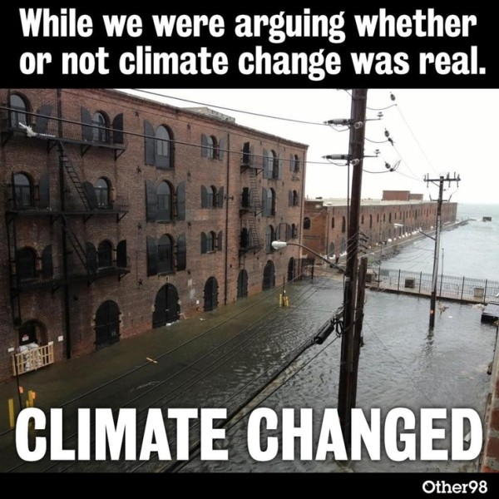
Notes:
Talk about how the majority of the world refuse to acknowledge the fact that is climate change, let alone find a feasible solution.

Slide 12
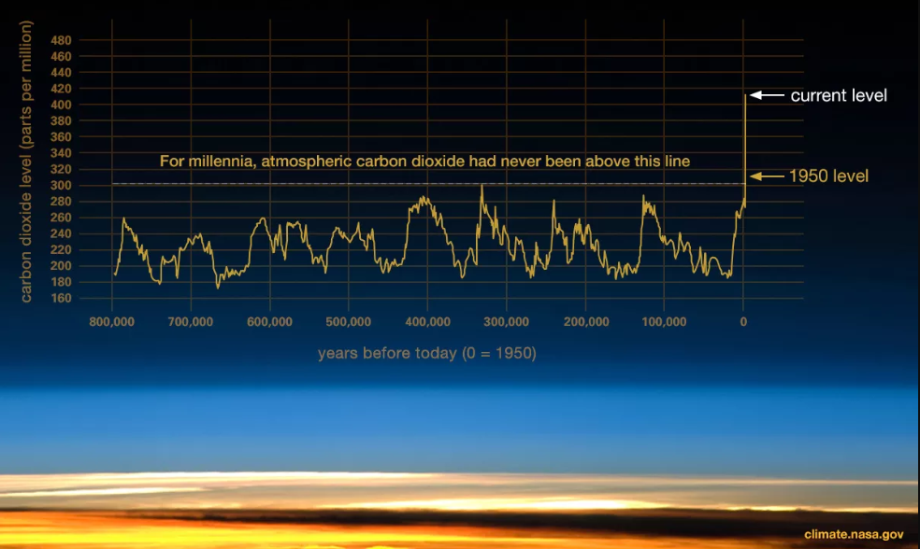
C02 Levels
Notes:
These are the co2 levels in the atmosphere.

Slide 13

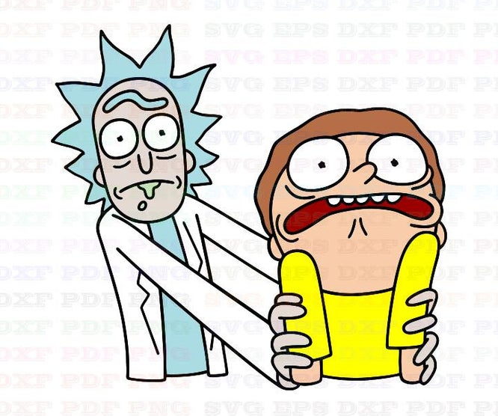
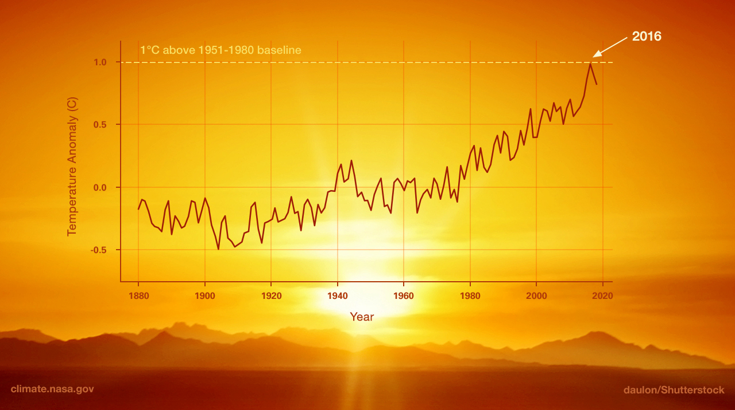
The Real Truth
Notes:
The Rise in temperature.

Slide 14


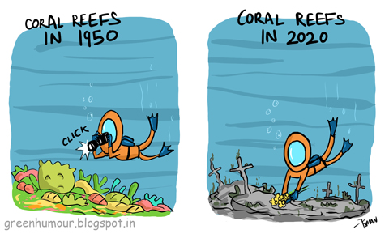
Current Projects
Carbon Engineering
Sola Roadways
New light technologies
Sky mines
Wind turbines
Afforestation
Terra Power
…
Notes:
Some of the project that are currently being implemented in the real world. so many projects and endeavours by innovative giants and creative nobodies.

Slide 15
Energy Miracle Strategy
Development of
New Technologies
R & D
Carbon tax
Notes:
This Strategy was proposed by Bill Gates.

Slide 16
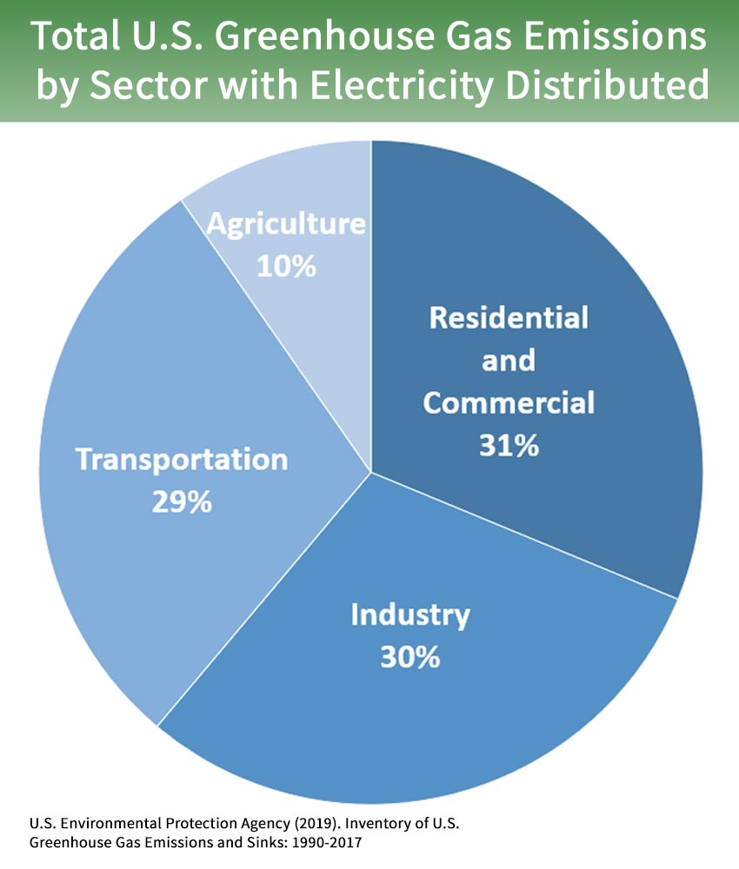
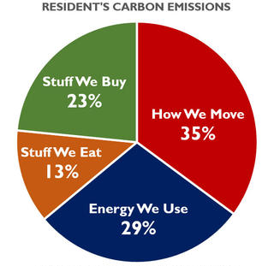
Our idea
Notes:
Left- U.S. Right – India , these graph show us that its what we do that affects our surroundings

Slide 17


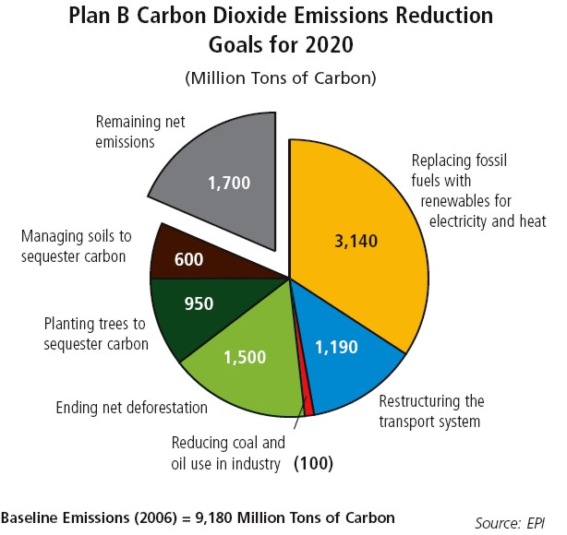
What to expect ?
Carbon Taxes.
100% used for sustainable development.
By solving problems like Global Warming.
Notes:
Solve everything in stages.

Slide 18


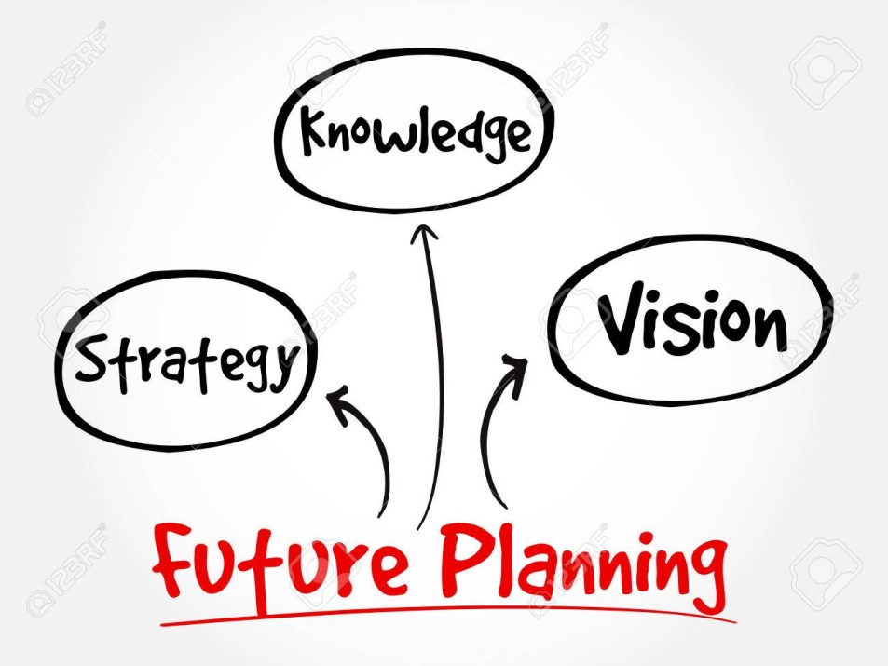
Military has helped us before and they can do that again by leading the way in this
“FIGHT FOR SURVIVAL”
We have to also think ahead of our time so that the coming generations can only imagine and not live in the Earth that they would have avoided
Notes:
Just involve military and future planning in the discussion to give it some weight.

Slide 19


More Ideas :
Nuclear Power
Eco-paving
Solid CO2
Artificial Trees
Cloud Seeding
Osmotic Generators
Graphene Filters
Green Exhaust System
Smart Power Distribution
Notes:
Talk a little about each one.

Slide 20
FINICKY PROJECTS
Masdar City.
Convert CO2 to carbon-foil.
Reduce the amount of sunlight we receive.
To bounce 1% of sun's rays back into space using the oceans.
Increase earth's albedo.
Can create a virtual simulation of Earth to study climate changes.
Notes:
Extra projects that are a little bit finicky. Masdar city - Zero waste ,Zero carbon, Fossil fuel free – city.

Slide 21

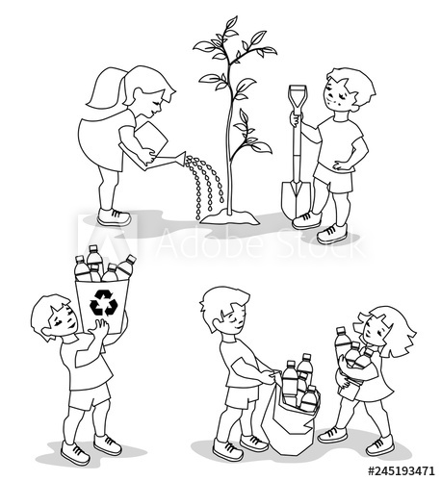
IN-ACTION IS AN ACTION
Notes:
At last to those who despair that the Paris climate accord didn't go far enough or your limited actions on their own wont solve the problem of global warming we say : “don't let the perfect be the enemy of the good” - moreover i think it helps us to contemplate the world we avoided.

Slide 22
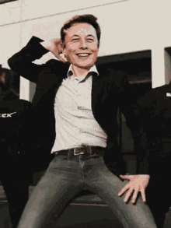
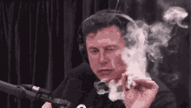

Notes:
Thanks.

